Slide 1
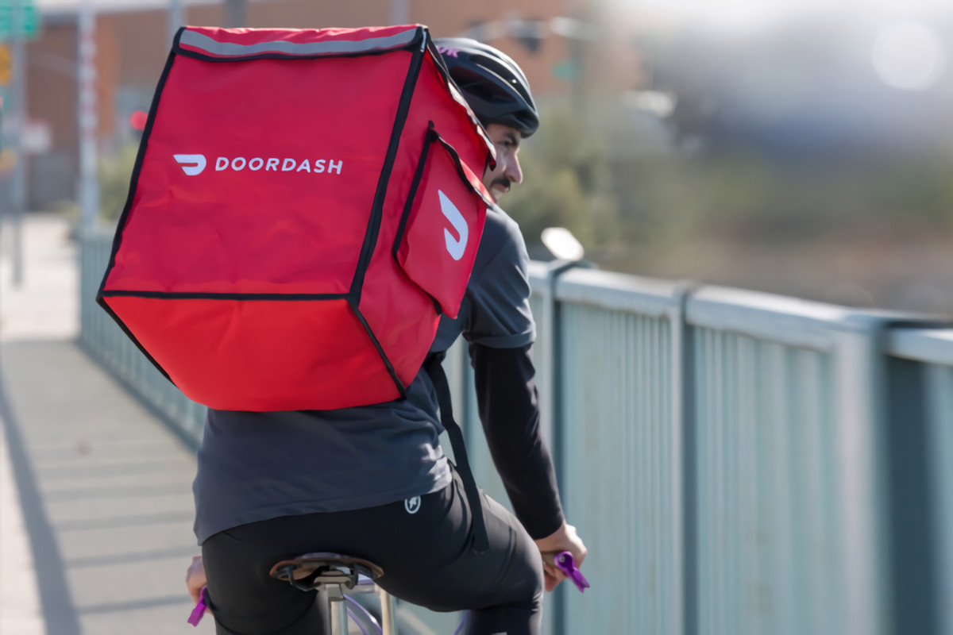

Product Pitch DoorDash Project scenarios
Product Owner: [Reham Dakhel Almaghathawi]

Slide 2

Background;-
DoorDash,Inc. operates an online food ordering and food delivery platform.
based in San Francisco. With a 56% market share,
is the largest food delivery company in the United States.
As of December 31, 2020, the platform served 450,000 merchants, 20,000,000 consumers, and 1 million deliverers
© 2019 Udacity. All rights reserved.

Slide 3
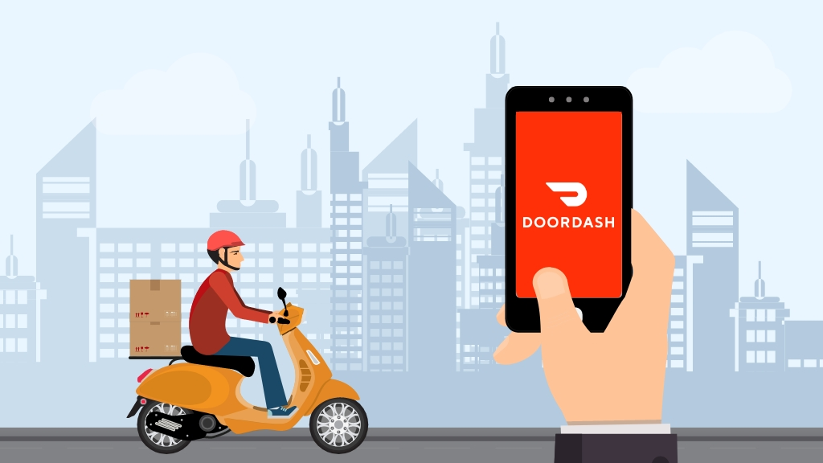
Business Case
© 2019 Udacity. All rights reserved.
Notes:
[ALL PARTICIPATION]

Slide 4
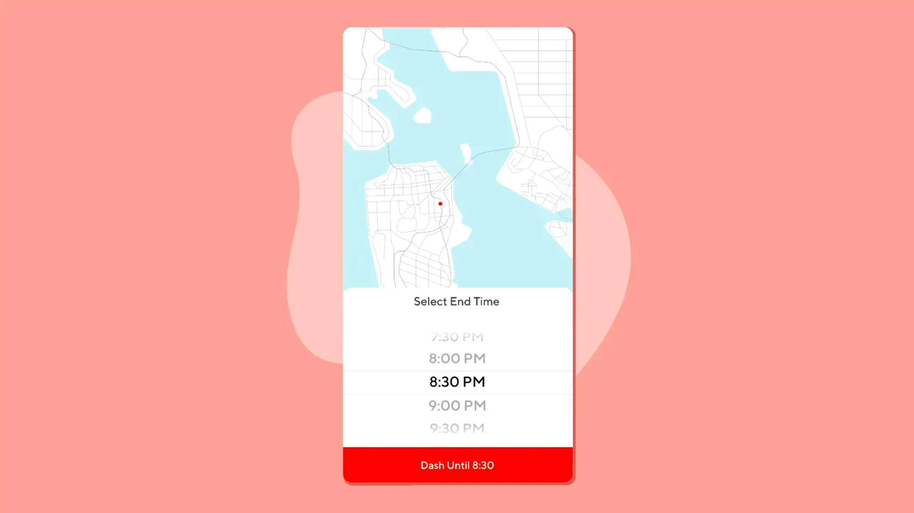
Initial Focus
Where are we starting?
The App showing menus from local restaurants is launched by our founders in Palo Alto, California. Today, we connect more than 390,000 traders, more than 18 million users and about 1 million Dashers through our local logistics platform in the United States, Canada and Australia. Our platform allowing local brick-and-mortar companies to flourish in today's comfort economy by responding easily and promptly to consumer expectations. Händler have made additional sales, consumer connections with the best of their neighborhoods and Dashers has found flexible economic opportunities thanks to over 900 million orders completed through our platform since we were founded.
© 2019 Udacity. All rights reserved.

Slide 5

Opportunity
In the fall of 2012, 4 students from Stanford University were getting feedback on a mobile app for small business owners when a macaroon store owner asked for help using technology for deliveries.
In January 2013, they launched PaloAltoDelivery.com in Palo Alto, California. Early customers were mostly students at Stanford University. In the summer of 2013, it received $120,000 in seed money from Y Combinator in exchange for a 7% stake. It incorporated as DoorDash in June 2013.
Nowdays, DoorDash is a technology company that connects people with the best in their cities.
Doing this by empowering local businesses and in turn, generate new ways for people to earn, work and live.
DoorDash started by facilitating door-to-door delivery, but we see this as just the beginning of connecting people with possibility — easier evenings, happier days, bigger savings accounts, wider nets and stronger communities.
© 2019 Udacity. All rights reserved.

Slide 6
Proposal
Value Propositions offered by DoorDash
Customer:
better pricing and efficiency.
Can order meals online
24×7 Customer Service
Can browse menus of various restaurants
Can track their order
Drivers:
Extended customer base
Get an online platform to serve their customers
Easy, cheap and a fast way of delivering orders
Empowerment of small restaurant owners
Drivery Person:
Earn good money
Flexible time slots
Delivery guys even receive tips from users
© 2019 Udacity. All rights reserved.

Slide 7
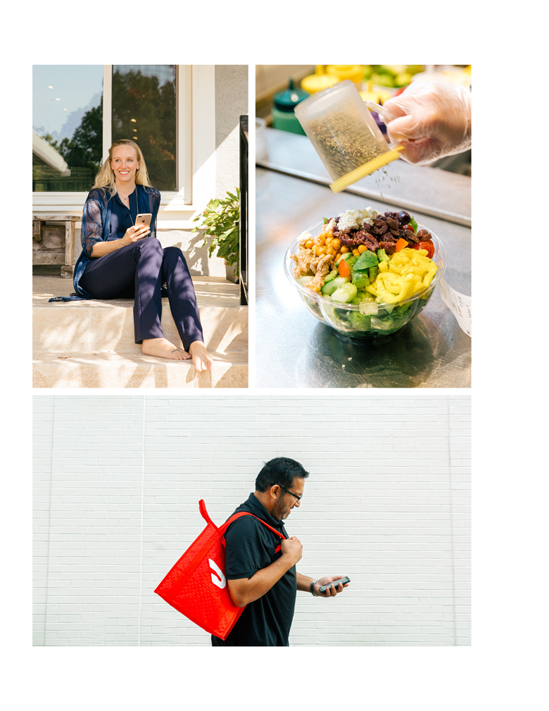
Return On Investment
The company has generated revenues of $885 million for the fiscal year 2019 according to its S-1 filing. In the first 9 months of 2020, DoorDash recorded an income of $1.916 billion, up almost 400 percent from the $587 million it made in 2019 over the same timespan.
DoorDash remains an unprofitable company, which was mainly driven by the pandemic, despite the exponential growth. It recorded a net loss of $667 million for 2019 while in the first 9 months of 2020, it still lost $147 million.
Total addressable market (TAM)
© 2019 Udacity. All rights reserved.

Slide 8
Return On Investment
Key Factors Affecting Cost
Infrastructure:
Interface Design
Development Platform
Maintenance + Support
App Upfradation
Human Resources required team structure for food delivery app development:
Project Manager UX/UI Developers Android/IOS developers Backend Developers QA Teams Delivery Manager
Merchant Workshops Assessment
Marketing Campaign Promotion
© 2019 Udacity. All rights reserved.

Slide 9
Return On Investment
Initial Infrastructure Cost
Initial Merchant Cost
Infrastructure in Dollar $:
Interface Design 8,000
( UI and UX )
Development Platform. 30,000
Maintenance + Support 5,000
App Upgradation. 11,000
Total. 54,000
preparing vendors in dollar $:
training video 10,000
support center 20,000
user manual 15,000
Total. 54,000
© 2019 Udacity. All rights reserved.

Slide 10
Return On Investment
Initial Human Resources Cost
Initial Marketing Cost
Infrastructure in Dollar$:
Promotion. 25,000
Campaign 12,000
Total. 37,000
Preparing staff in Dollar$:
Project Manager. 115,000
UX/UI Developers 97,000
Android/IOS developers. 115,000
Backend Developers. 75,000
QA Teams 50,000
Delivery Manager. 102,000
Total. 554,000
© 2019 Udacity. All rights reserved.

Slide 11
Return On Investment
Cost overview
Category Amount in Dollar$
Infrastructure 54,000
Merchant 54,000
Resources. 554,000
Marketing. 37,000
Total. 699,000
Amount Gained – Amount Spent
X 100 %
Amount Spent
699,000 – 50,000
X 12.98 %
50,000
© 2019 Udacity. All rights reserved.

Slide 12

Measurement
Being technologically-driven
“DoorDash is a fan of the ‘simple is best’ motto”
Differentiating from the competition
“its secret is in its differentiation”
Keeping their options open
“The brand is set up to establish itself and then expand its product offering”
The blend of brand and performance(well-recognized)
”a trait that consumers value highly”
Informed international expansion
“this is key to its successful (and rapid) growth both nationally and internationally”
© 2019 Udacity. All rights reserved.

Slide 13
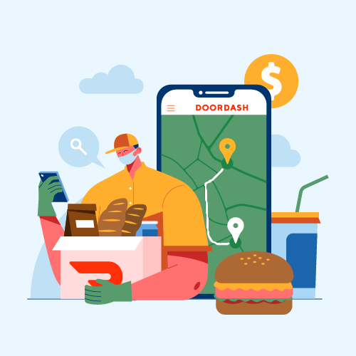
Competitors
© 2019 Udacity. All rights reserved.
Notes:
[ALL PARTICIPATION]

Slide 14

GrubHub
What is GrubHub?
Grubhub helps you find and order food from wherever you are. How it works: you type in an address, we tell you the restaurants that deliver to that locale as well as showing you droves of pickup restaurants near you.
Seller Details:
Seller
GrubHub
Ownership
NYSE:GRUB
Company Website
www.grubhub.com
HQ Location
New York, NY
Total Revenue (USD mm)
$1,819
Twitter
@Grubhub 213,331 Twitter followers
GrubHub Details:
Website
GrubHub
Discussions
GrubHub Community
© 2019 Udacity. All rights reserved.

Slide 15

Deliveroo
What is Deliveroo?
Deliveroo is a technology company focused on marketing, selling and delivering restaurant meals to the household or office. Its technology platform optimizes food ordering and delivery by integrating web and mobile consumers with restaurant tablet-based point-of-sale order management terminals and logistics optimization algorithm via its delivery driver smartphone software.
.
Deliveroo Details
Website
Deliveroo
Discussions
Deliveroo Community
Seller Details:
Seller
Deliveroo
Company Website
deliveroo.co.uk
Year Founded
2012
HQ Location
London, United Kingdom
Twitter
@Deliveroo 67,391 Twitter followers
LinkedIn® Page
www.linkedin.com 6,514 employees on LinkedIn®
© 2019 Udacity. All rights reserved.

Slide 16
Our Advantages
The three apps with the largest market share in the space, DoorDash , Grubhub and Deliveroo offer users a way to earn money working independently on their own schedule,
they differ in a few key features that might make one a better option than the other for some users
Key Features:
1. Requirements for Drivers
2. Driver Payment
3. Driver Extras
2019 Udacity. All rights reserved.

Slide 17


Deliveroo Deliveroo is a technology company focused on marketing, selling and delivering restaurant meals to the household or office. | GrubHub GrubHub provides an online and mobile platform for restaurant pick-up and delivery orders. | DoorDash DoorDash is a technology company that provides on-demand delivery service connecting customers with local businesses.
2012 | 2004 | 2013 | Founding Date
Privte | Subsidiary | Public | Type
Food & Beverage Technology delivery marketing analytics mobile app platform processed food restaurant | Food & Beverage Technology delivery marketplace mobile app platform restaurant | Food & Beverage Technology application software consumer software delivery nutrition platform restaurant | Tags
7 billion | 7.1 billion | 50.2 billion | Valuation ($)
2019 Udacity. All rights reserved.

Slide 18
Financial
N/A | $1.8b (FY, 2020) | $2.9b (FY, 2020) | Revenue (est.)
(£232m) (FY, 2018) | ($155.9m) (FY, 2020) | ($461m) (FY, 2020) | Net income
Operating
500 (May, 2019) | 1.6 k (Q2, 2018) | N/A | Active Cities
80 k (May, 2019) | 85 k (Q2, 2018) | N/A | Net income
Funding
$ 1.7b | $ 284.1m | $ 2.5b | Total funding raised
2019 Udacity. All rights reserved.

Slide 19
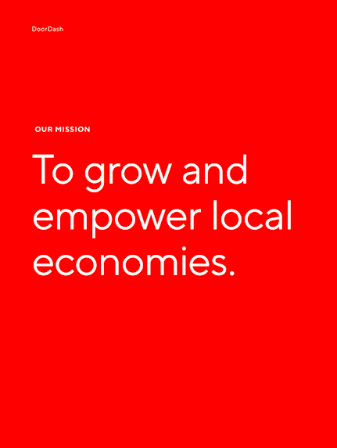
Roadmap and Vision
© 2019 Udacity. All rights reserved.
Notes:
[ALL PARTICIPATION]

Slide 20
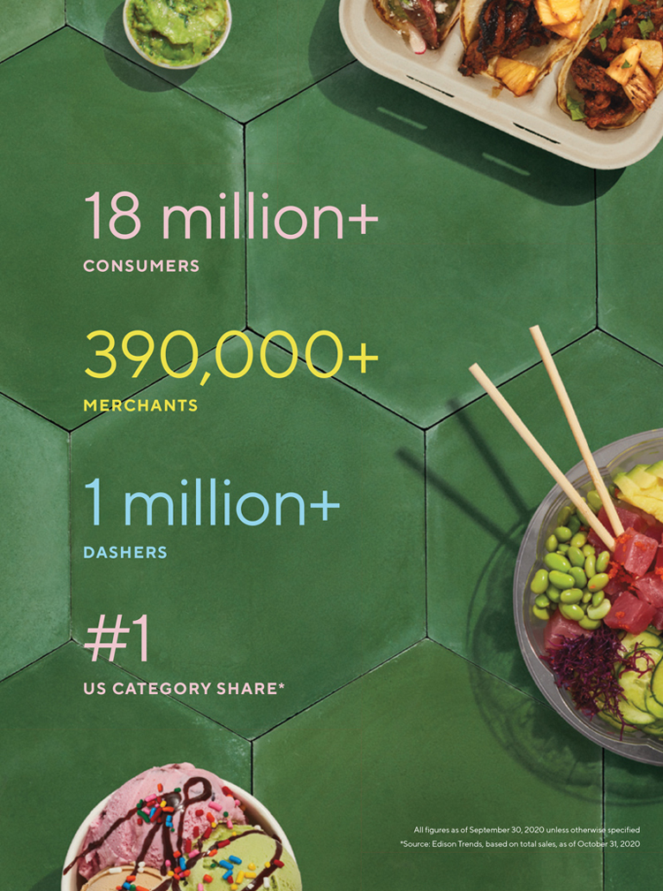
Roadmap Pillars
Our vision - which will take decades to realize - is to build a last-mile logistics platform, create a set of services to grow a merchant s sales, and produce a membership program that connects consumers to the merchants that sustain them.
© 2019 Udacity. All rights reserved.

Slide 21
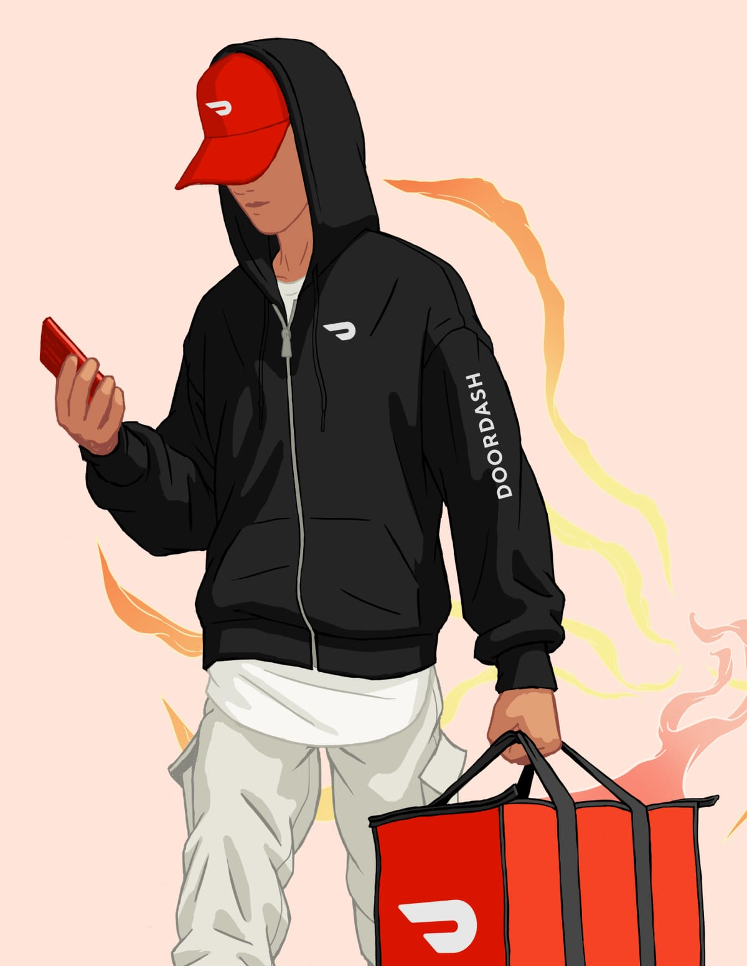
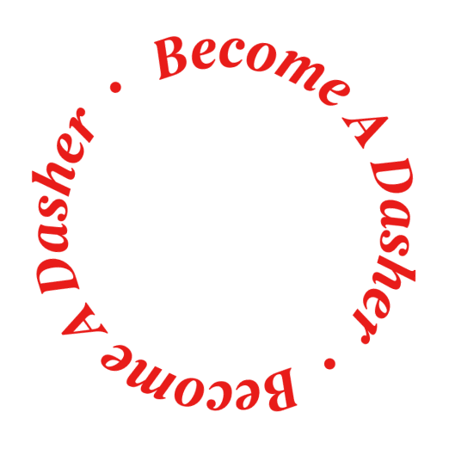
BECOME A DASHER
01
02
03
Earn with the best.
Deliver with the #1 Food and Drink App with a network of top-rated restaurants and convenience stores across the U.S., Canada, and Australia.
Work when you want.
You decide when, where, and how much you work. And whether you ‘Dash Now’ or schedule when you deliver, you can forget about reporting to an office — or a boss.
Set your own course.
Choose whether or not to accept deliveries, find demand near you, and earn more with promotions like Challenges and Peak Pay in the Dasher app.
© 2019 Udacity. All rights reserved.

Slide 22
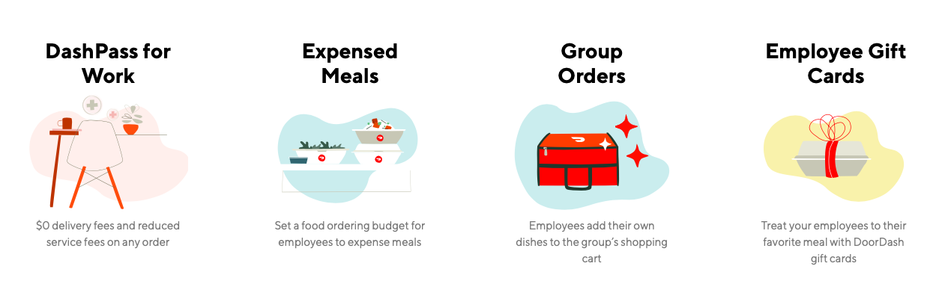
DoorDash For Work
DoorDash for Work allows companies to subscribe their employees to DashPass. The service is aimed at employees that were forced to work from home because of the pandemic.
© 2019 Udacity. All rights reserved.

Slide 23
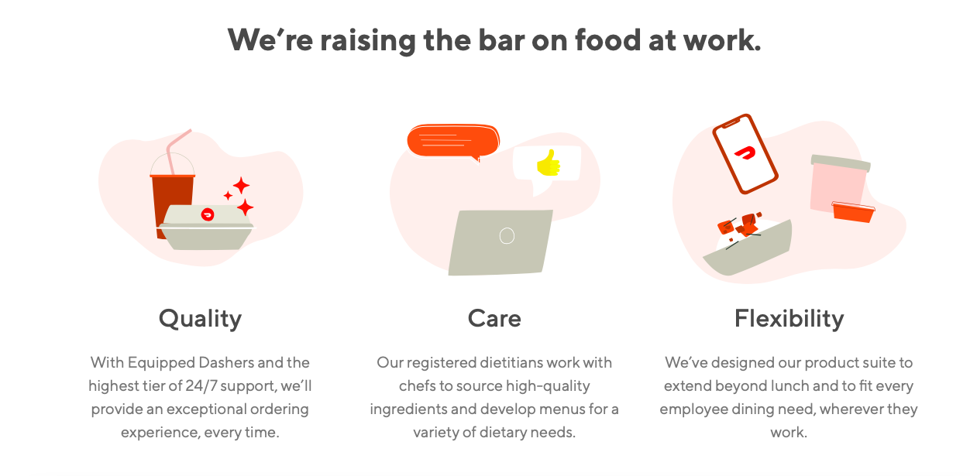
© 2019 Udacity. All rights reserved.

Slide 24
Where do we go from here?
Project DASH
$165 billion worth of food is wasted every year. 16 million U.S. households go hungry.
And how we’re using our platform to help tackle this problem.
© 2019 Udacity. All rights reserved.

Slide 25
The DASH Project is our new initiative to address the problems of hunger and food waste in the local communities we serve. The project focuses on the development of the doorDash legislation. The average restaurant has an excess of 100,000 pounds of food each year1, although only 0.4% of it is donated. 78% of the restaurants cite transport for donations of more food, making the most commonly cited roadblock for increased food rescue for last-mile logistic services. Project DASH is followed by DoorDash's passionate employees, logistics of last miles, millions of consumers, hundreds of thousands of Dashers and ten thousands of restaurant partners across more than 600 cities.
Project DASH consists of the follow
1:1 Meal Donation
WeDash For Good
Reducing Food Wa
© 2019 Udacity. All rights reserved.

Slide 26
For sources of this data
https://www.askattest.com/blog/strategy/doordash-growth-strategy
https://craft.co/doordash/competitors?competitors=doordash%2Cgrubhub%2Cdeliveroo
https://productmint.com/the-doordash-business-model-how-does-doordash-make-money/
https://dasher.doordash.com/en-us/
https://work.doordash.com
https://agiletech.medium.com/doordash-business-model-revenue-sources-9bde771f1d0e
https://www.g2.com/products/deliveroo/reviews
https://www.g2.com/products/grubhub/reviews
https://www.spglobal.com/marketintelligence/en/news-insights/latest-news-headlines/doordash-poised-to-grow-despite-challenges-experts-say-ahead-of-public-debut-61596291
https://medium.com/flutter-community/how-much-does-it-cost-to-make-an-mobile-app-like-ubereats-and-deliveroo-df3a5cd52733
https://get.doordash.com/profit-calculator#
https://ir.doordash.com/overview/default.aspx
© 2019 Udacity. All rights reserved.

